Slide 1


Slide 2
Co-Construct Estimator
Supervisor:
Mr. Armughan Ali
Group Member:
Muhammad Shawaiz (FA17-BCS-017)
Saad Ahmed (FA17-BCS-056)
Program:
BS-Computer Science

Slide 3
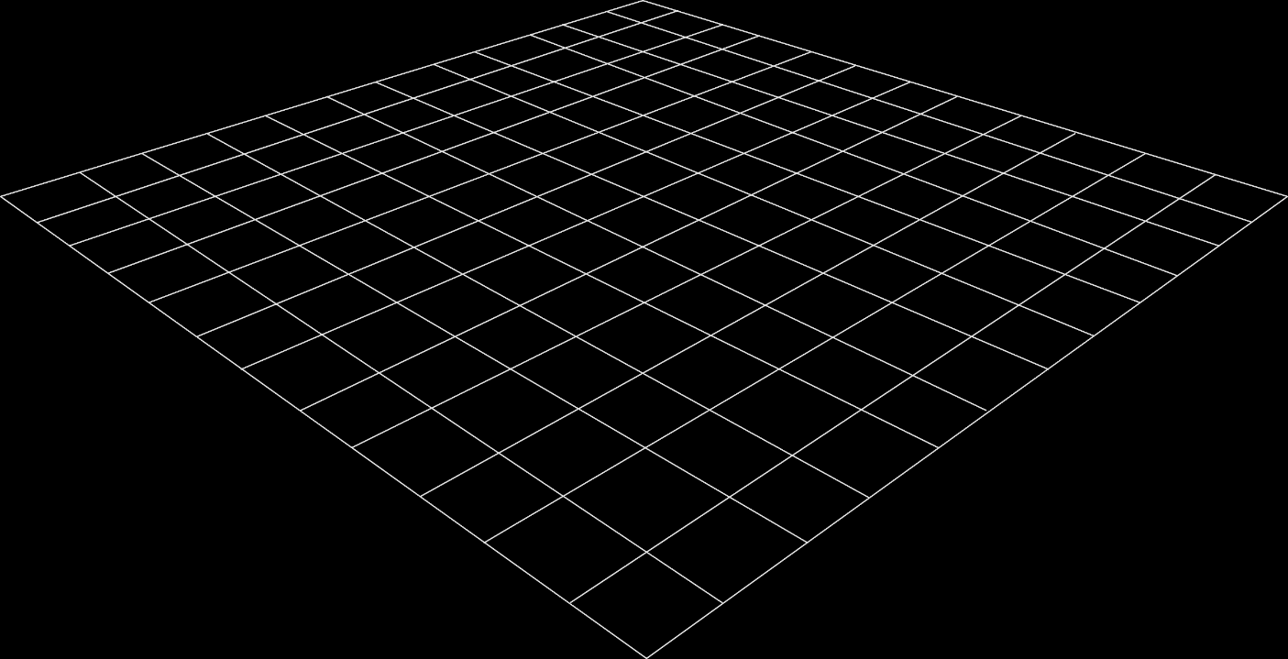
Outline
Introduction
Problem Statement
Goals and Objectives
Methodology
Benefits
Tools and technologies
Functional Requirements

Slide 4
Outline (cont.…)
Non-Functional Requirements
Diagrams
User Interface
Future Work

Slide 5
Introduction
An Android based application to help common people
Gives the user precise estimated cost for a construction project in a precise way
Overcome manual methods of estimating cost of construction projects
Provides user to make large scale project estimates
Provides facility to find contractors according to the specialty and requirement
Location to find the nearest contractor according to requirements

Slide 6
Problem Statement
Manual approach to make estimates
Manual methods are prone to errors as cost of construction materials fluctuate time to time
Customers often get scammed by contractors just because of lack of knowledge
Cost overflow has been the major drawback in construction which leads to abandonment of most projects

Slide 7
Goals and Objectives
Following are our objectives and goals behind this project, which are enlisted below.
Give user an educated cost estimation
Help people finding the right contractor for their job
Help the Contractors to have the idea of market rates
Common person can have in advance idea about expected cost and cannot be scammed by contractors.

Slide 8
Methodology
The Contractor have to first make their account by signup and then login by entering valid E-mail, username and
password
The contractor have profile from where a user can find contractor meanwhile the contractor is just allowed
to provide location, service, and price including labor cost.
The user is allowed to make estimates according to his needs and requirements.
The app will respond and give estimates according to the given parameters.
The user can also find and contact contractors according to location, prices and service defined.

Slide 9
Benefits
Provides upfront cost estimation to the user.
Provide estimate about the cost of construction material and labor to the contractors.
Provide the best person for the job.
Encourage people to use technology instead of using old methods.
Reduces the probability of scams.

Slide 10
Tools & Techniques
Relation | Tools
User Interface & Development | Android Studio
Designing | Android
Coding | Java
Database | Firebase
Programming Language | Java/Python
Training Model | Machine Learning

Slide 11
Functional Requirements
Requirements are important part of software development. Before starting a project, requirements are gathered, to formulate and manage the designing phase.
Interface Design
Making the user interface is essential part of project. For that purpose, advanced responsive and attractive interface will be designed using Android Studio and Java.
Training Model
Making educated and nearest exact estimates is not an easy task, dataset and machine learning algorithms are required to train models accordingly.
Location
The user will be provided ease to find the nearest buyer according to needs and requirements.

Slide 12
Non-Functional Requirements
Non-Functional requirement defines a function and its components.
Performance
We are trying to achieve best performance for our app, but this project involves large scale calculations and training datasets, so it would affect efficiency.
Availability
Users can access the system anytime, anywhere.
User friendly
Interface of app will be easy to use so that a beginner can also use it easily.

Slide 13
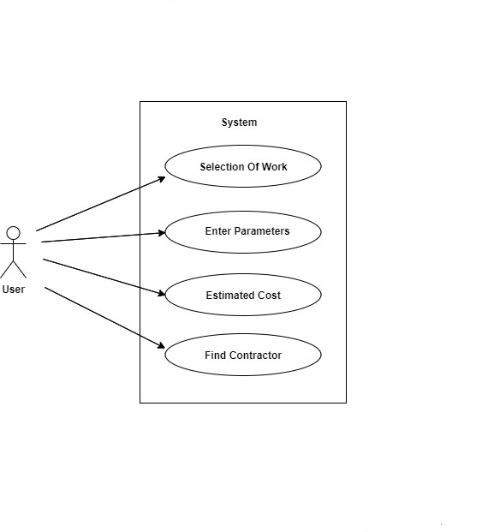
Use Case Diagram
User:

Slide 14
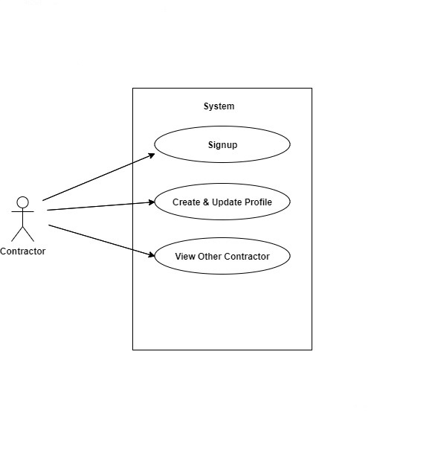
Detailed Use Case Diagrams
Contractor:

Slide 15
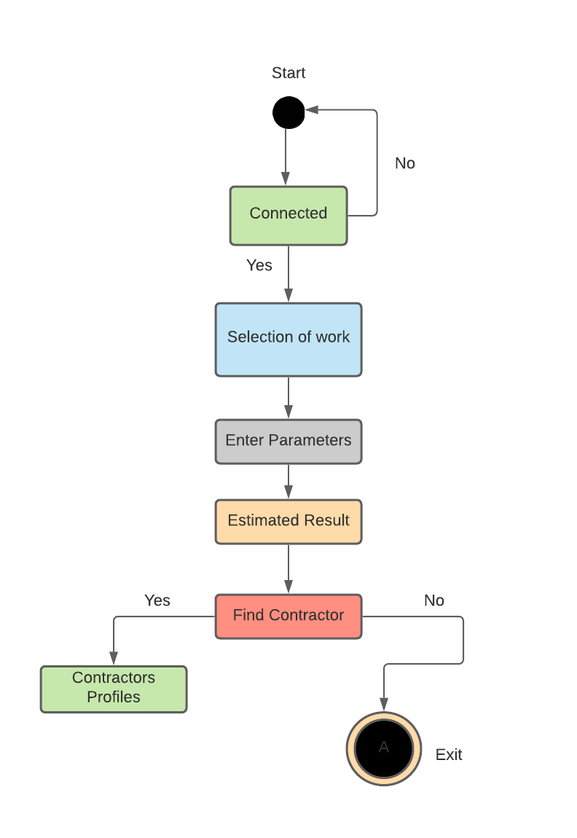
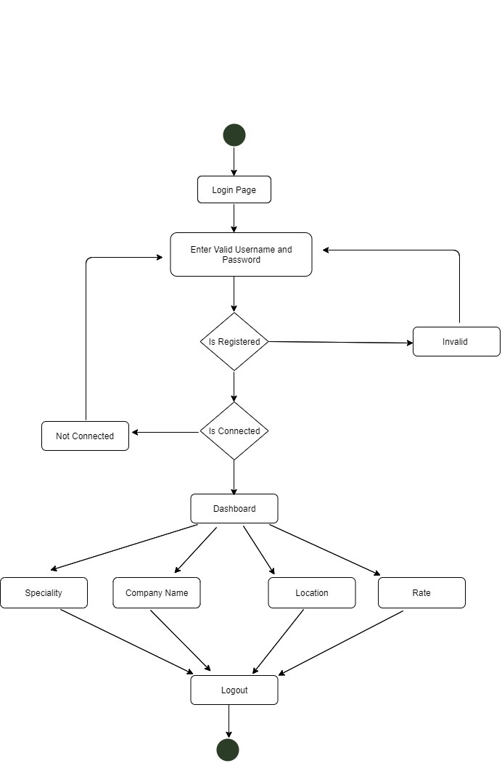
Activity Diagrams

Slide 16
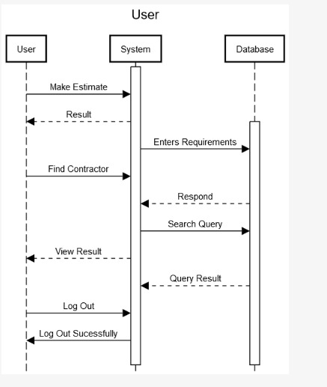
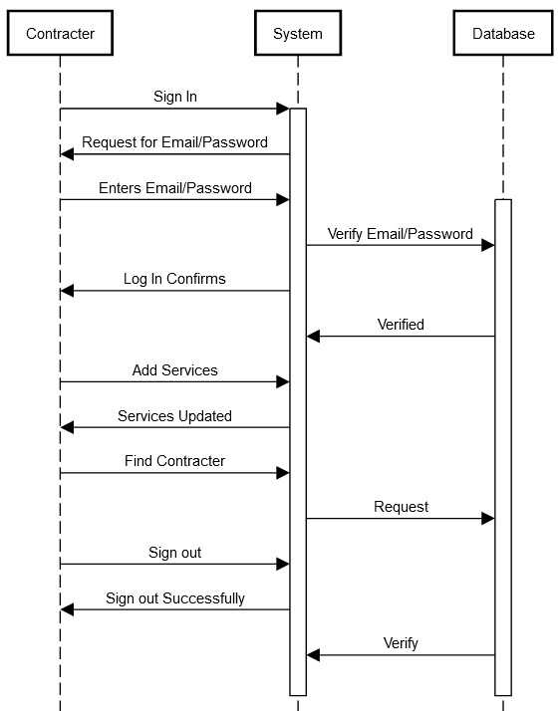
Sequence Diagram

Slide 17
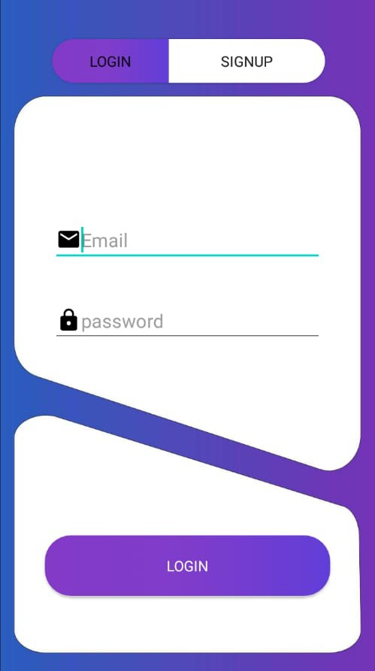
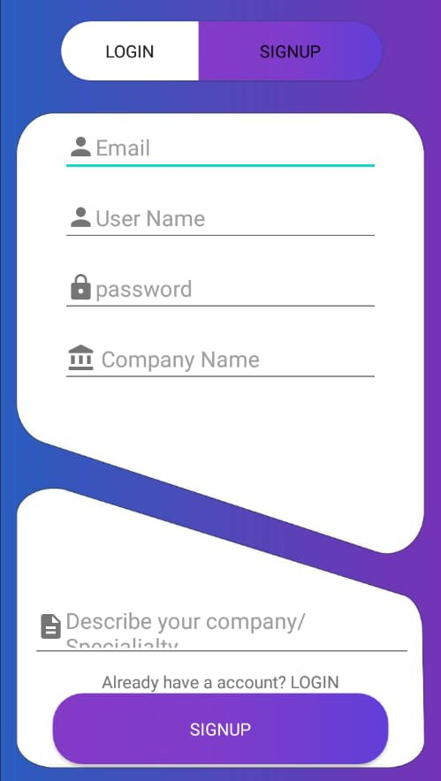
User Interface
Login/Register
Username | User will enter a unique username.
Email | User should enter a valid Email
Password | User needs to enter a password. Password should be at least 4 Characters long

Slide 18
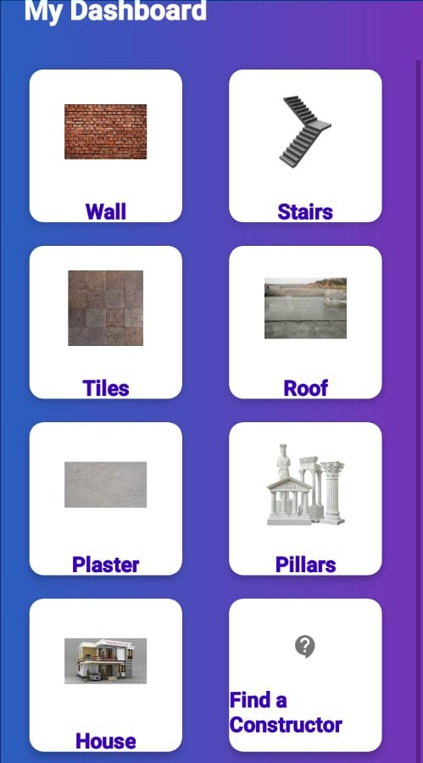
User Interface
Dashboard
Dashboard | After logging in, the dashboard will appear to user where the user can make estimates
Cancel | The dashboard provides user to make estimates and find contractor
Connection | Display of the dashboard is available even when connection is not available

Slide 19
Future Work
We have found out few limitations in the project during the development of this project, so we have decided to make it more efficient and better in future.
We will improve the app to make things more easy to use.
We will improve the Regression algorithm for better, faster and closest educated estimates.
We will add Chat system for user and contractor to make.
We will provide location system through Google maps to provide user ease to find nearest and perfect contractor for the job according to specialty and requirement.

Slide 20
Conclusions
Provides ease to common users
The user will get precise estimates according to requirements
The user can calculate large and small scale estimates in consonance with the requirements
The user will be able to find contractor on the basis of query search
The contractors will provide services accordingly to their expertise

Slide 21
References
G.-H. Kim, S.-H. An, K.-I. KangComparison of construction cost estimating models based on regression analysis, neural networks, and case-based reasoningBuild. Environ., 39 (10) (2004), pp. 1235-1242
D.J. Lowe, M.W. Emsley, A. HardingPredicting construction cost using multiple regression techniquesJ. Constr. Eng. Manag., 132 (July (7)) (2006), pp. 750-758View Record in ScopusGoogle Scholar
R. SonmezReview of conceptual cost modeling techniquesAACE Int. Trans. (2005), pp. EST.07.1-EST.07.4Google Scholar
C. Koo, T. Hong, C. HyunThe development of a construction cost prediction model with improved prediction capacity Expert Syst. Appl., 38 (7) (2011), pp. 8597-8606ArticleDownload PDFView Record in Scopus

